Slide 1
Define: POVs, HMWs & Experience Prototypes
Assignment 2

Slide 2
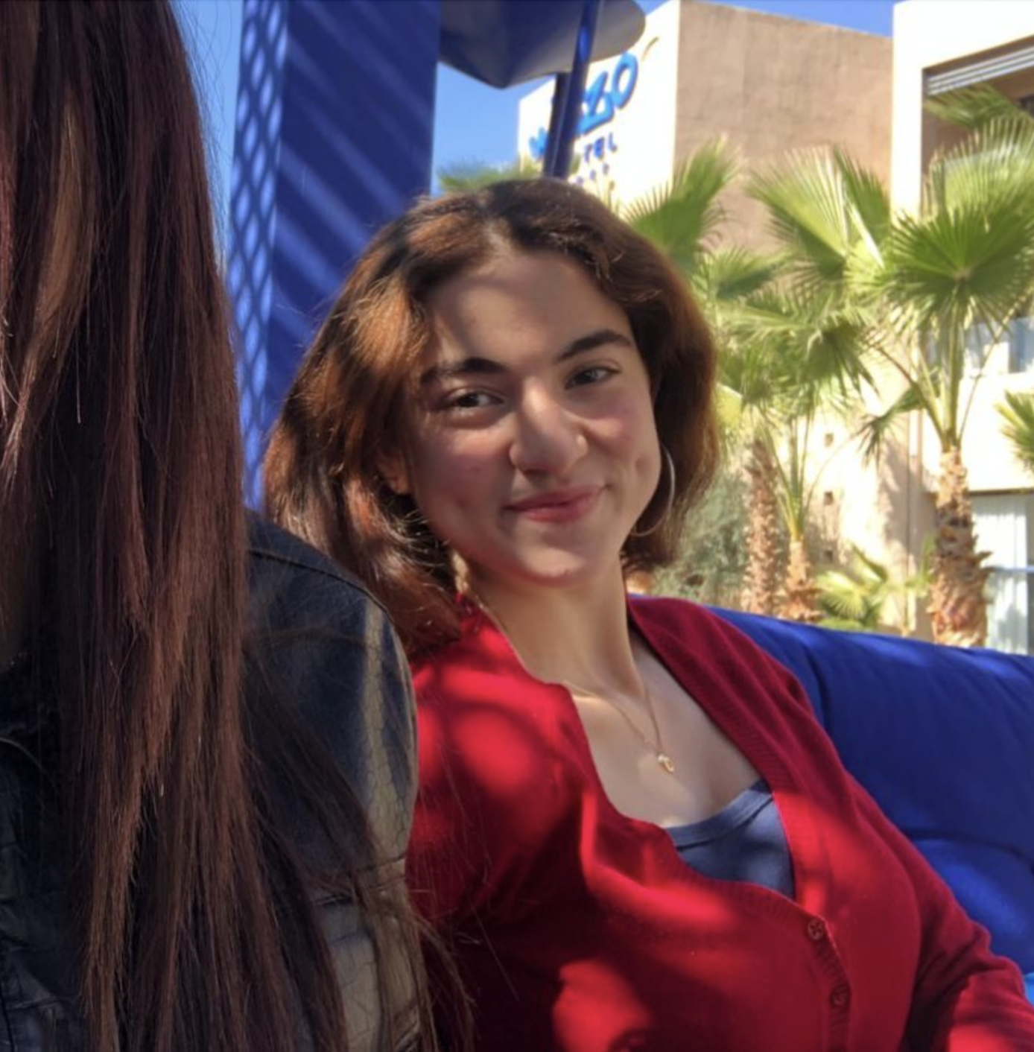
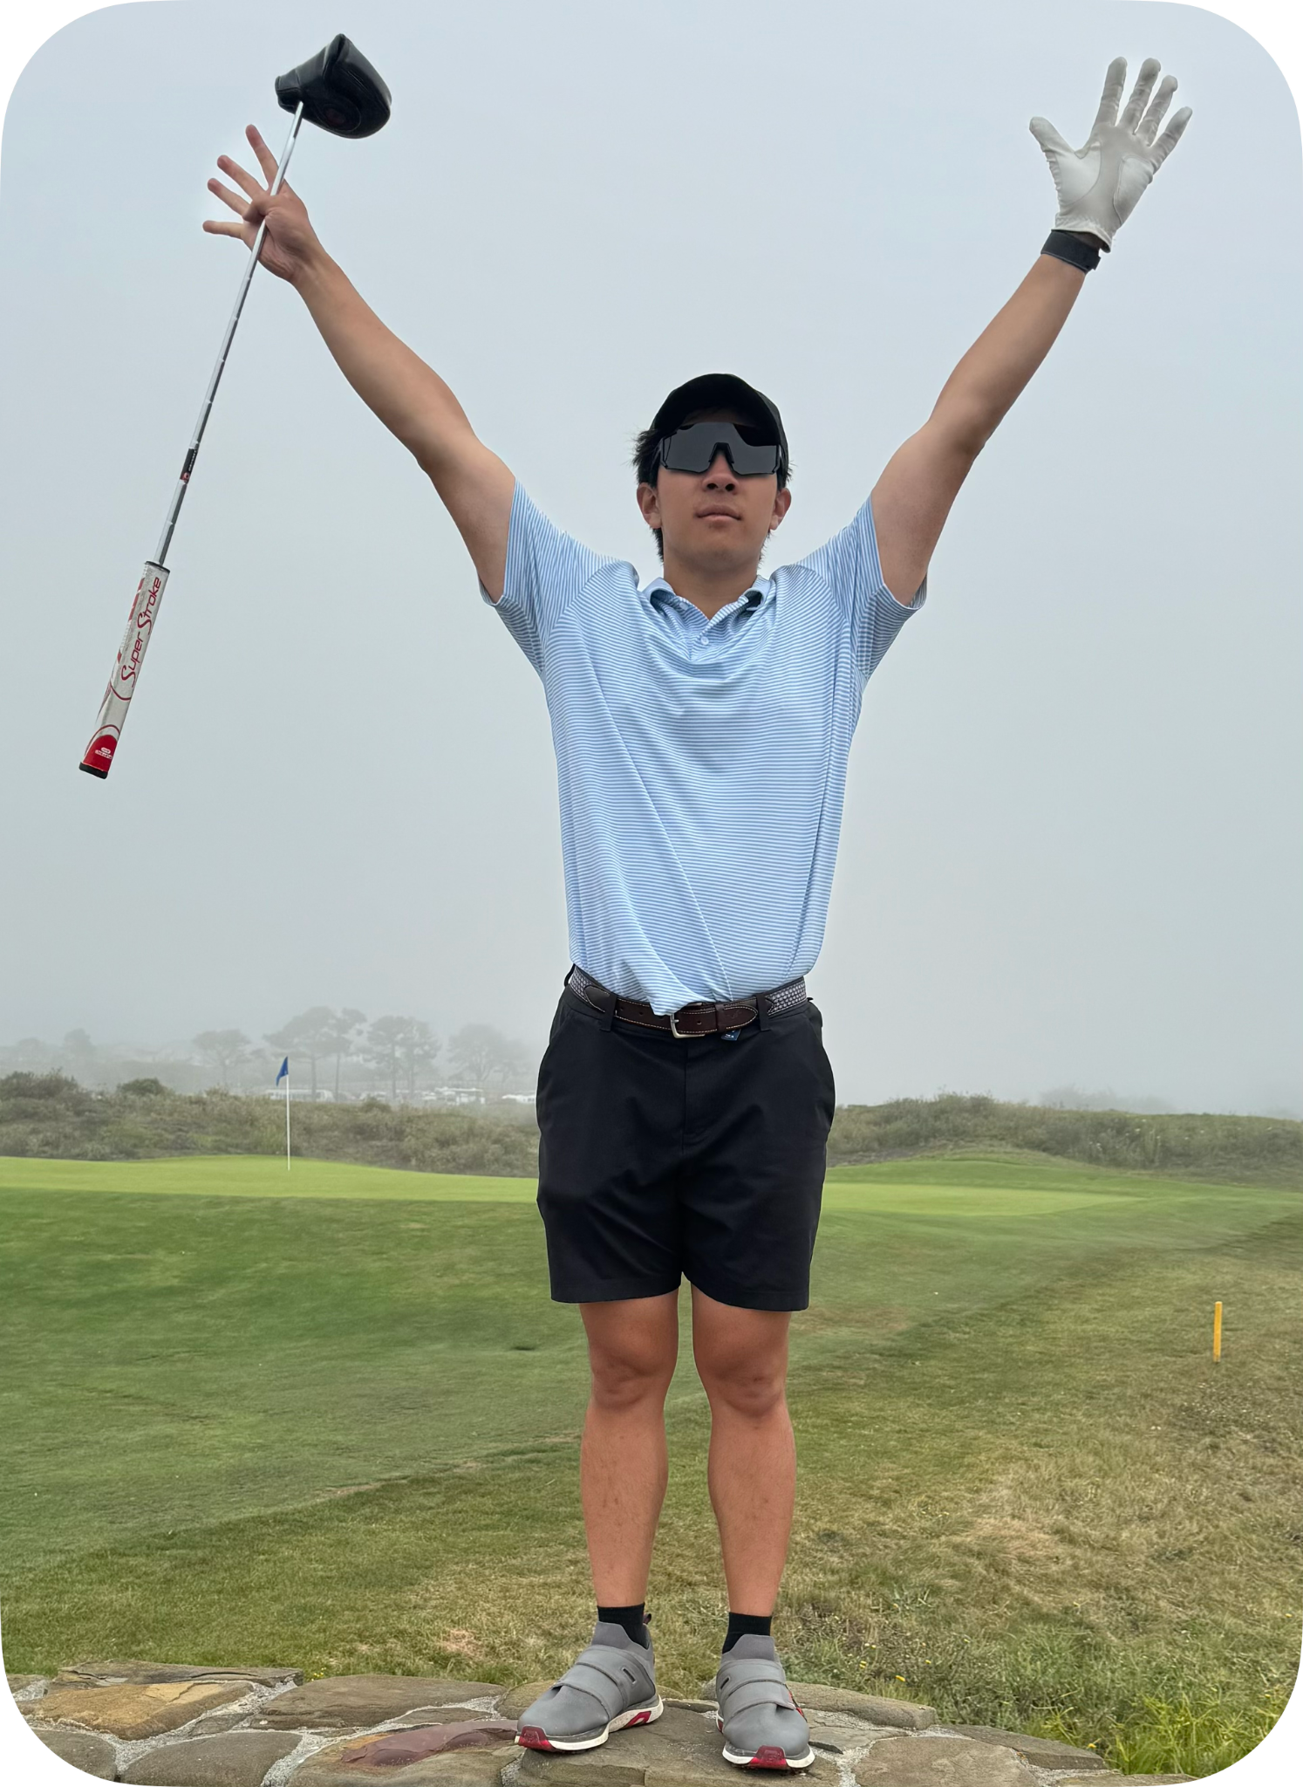


Team Intros
Taralyn
Maroua
Nick
Varsha
Class of 2026
Computer Science,
Human Computer Interaction
Class of 2026
Computer Science,
Human Computer Interaction
Class of 2026
Computer Science,
Human Computer
Interaction
Class of 2024 (2025?)
Mechanical Engineering,
Product Realization

Slide 3
Original problem domain: Stress

Slide 4
Refine problem Domain Stress in the Workplace
Refined problem domain: Stress from High Productivity and Achievement

Slide 5
Additional needfinding results and key findings
01

Slide 6


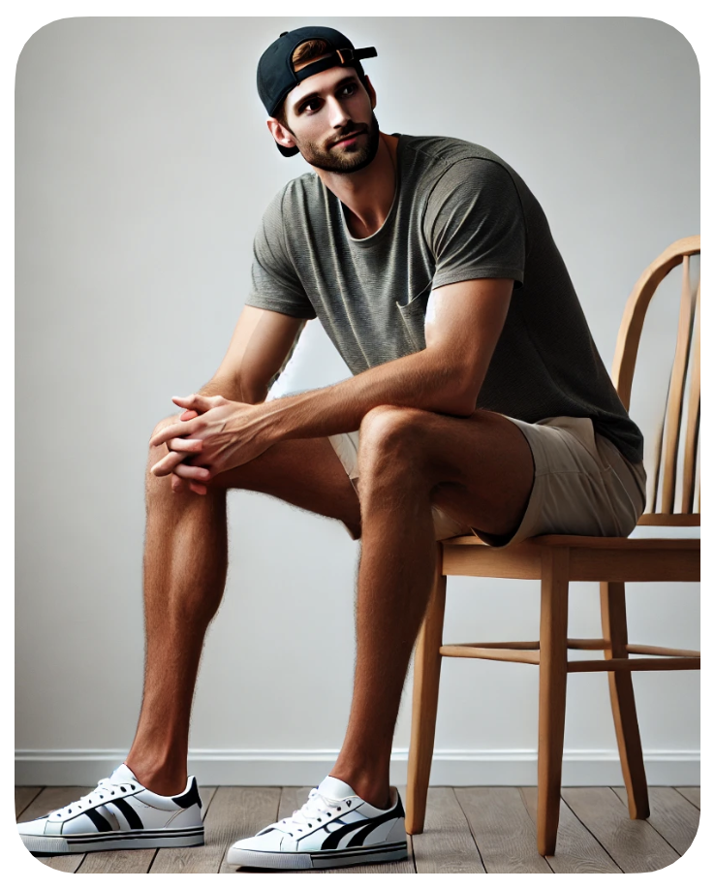

Old Interviews
Old Interviews
Julie (55)
Emi (20)
James (30)
Danna (17)
Has idealistic habits but struggles to fully implement them
Balances work and life while thriving on high achievement
Understands stress management down to a science
Navigates the pressures of competitive high school culture

Slide 7


New Interviews
Dr. V
Dr. Luce
After narrowing the scope of our problem domain, we interviewed people who could provide valuable insights about Stress from High Productivity and Achievement

Slide 8
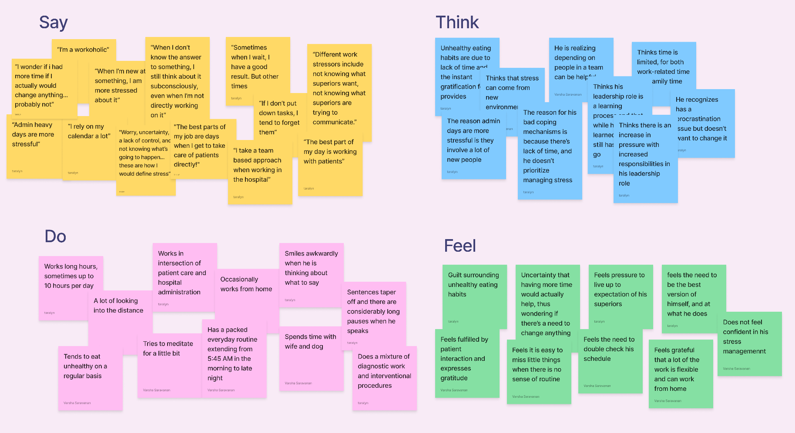
Dr. V
Interventional radiologist, considers himself a “workaholic”

Slide 9
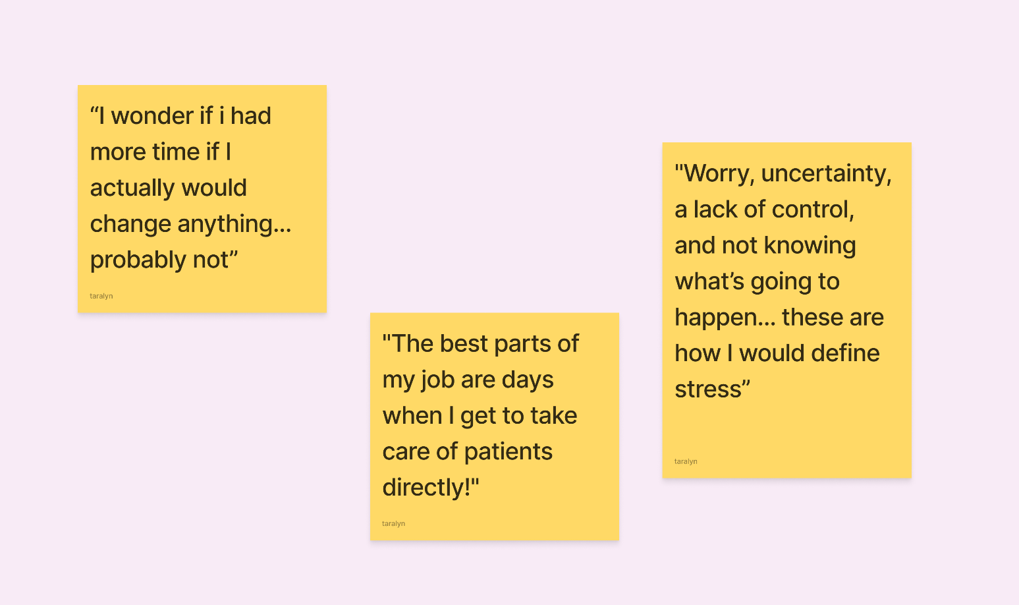
Dr. V’s Key Quotes

Slide 10
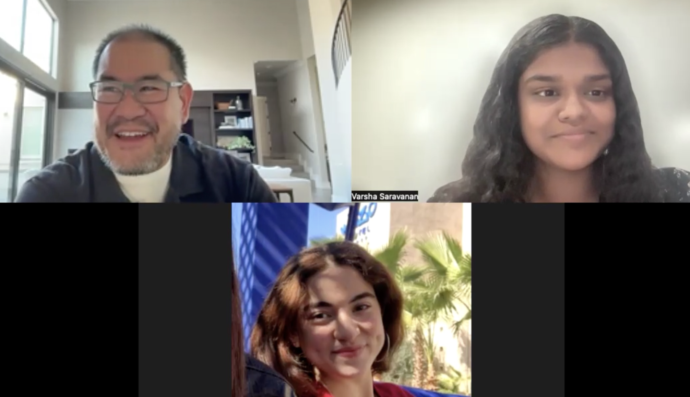

Slide 11
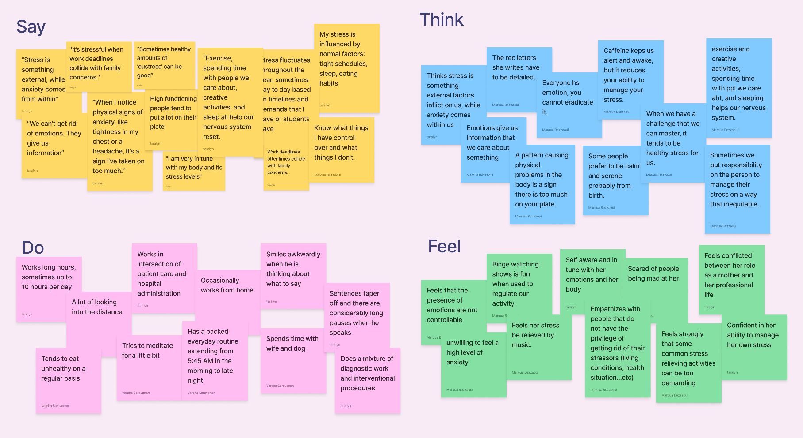
Dr. Luce (Domain Expert)
Licensed psychologist + clinical professor of psychology

Slide 12
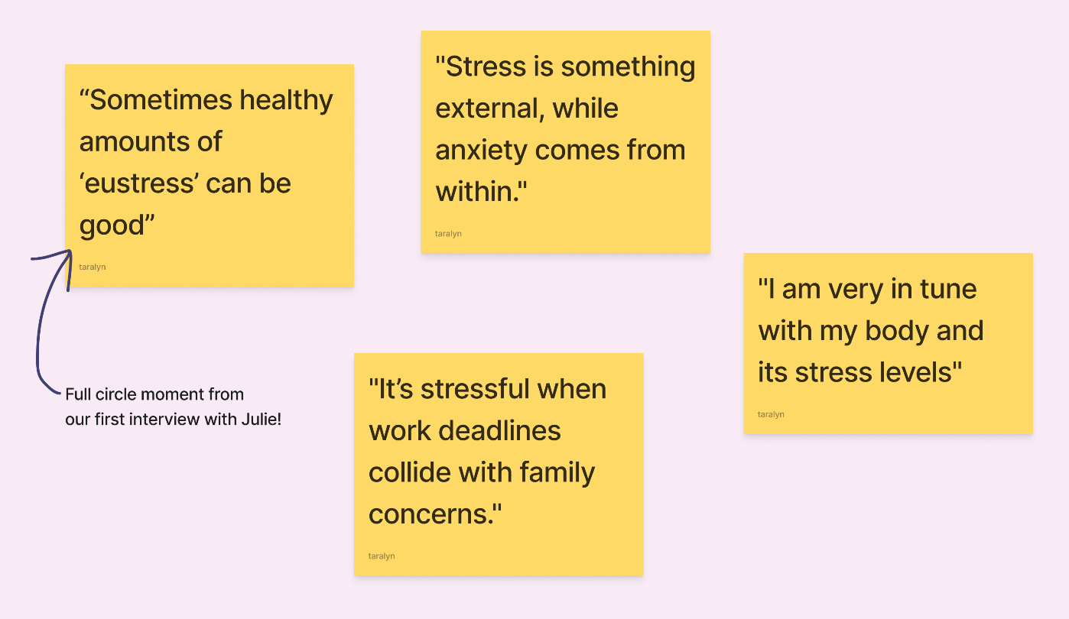
Dr. Luce’s Key Quotes

Slide 13
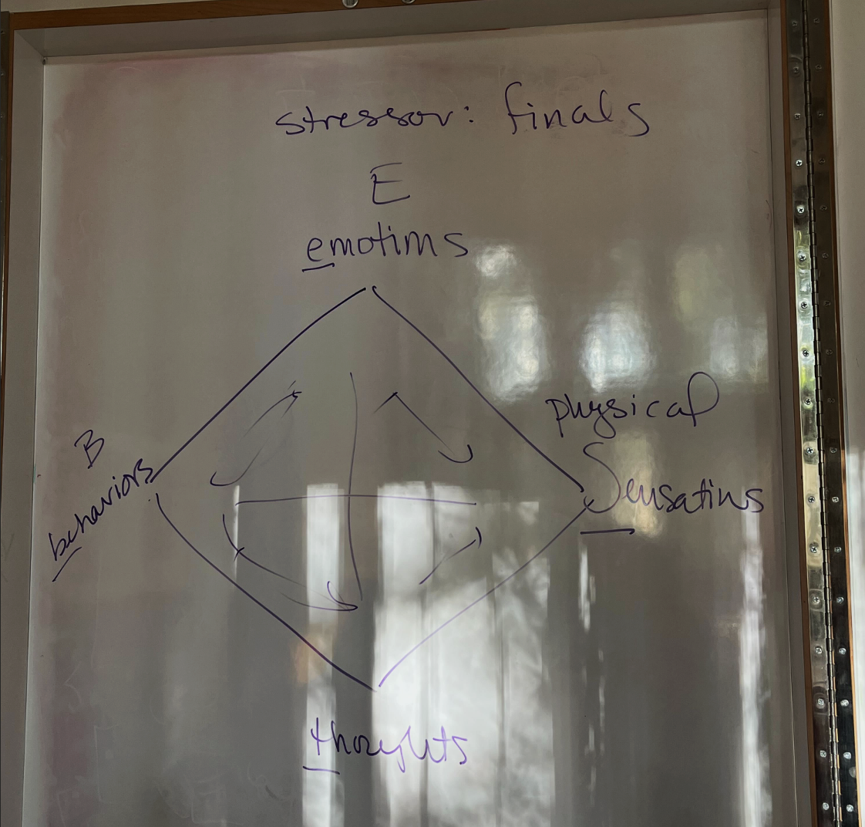

Slide 14
Key Insights
Dr. V:
There can be a lot of anxiety surrounding a lack of control or uncertainty in a professional context
Some people feel more fulfilled when they see the direct impact their work is making
Having more time, and thus less stress, does not equate to getting more done
Dr. Luce:
A person is past their threshold for stress when they start to notice signs of physical decline
Being in tune with your personal physical and mental wellbeing can help to reduce stress
There is such thing as healthy amounts of “good stress”. This “eustress” can serve as a motivator for some

Slide 15
POVs and HMWs

Slide 16
Danna: POV
We met…
Danna, a high achieving high school senior with lots of expectations on her.
We were surprised to notice…
Despite her awareness and frustration with the self-destructive, competitive Bay Area culture, she fed into it by letting pride prevent her from quitting AP Chemistry, even though it "ruined her year" and caused intense struggle.
We wonder if it means…
Danna has an internal fear of going against the status quo.
It would be game changing if…
We can maintain a sense of fulfillment and value in going against the grain / doing something different.

Slide 17
Danna: HMWs
HMW foster a societal shift from being accomplishment-driven to valuing personal growth and well-being?
HMW reframe failure as an essential part of learning and success, rather than something to hide?
HMW empower young individuals to explore future possibilities without feeling restricted by convention?
Notes:
Brainstorming:
Hmw remove the fear surrounding taking a different path
Hmw give people a safe place to experiment with different paths
Hmw connect danna with people who took unconventional paths
Hmw give danna the resources to pursue different paths
Hmw remove the stigma others cast on those following an unconventional path
Hmw ensure danna receives validation and value if she were to take a different path
Hmw place more emphasis on the journey and the process, rather than the end result
Hmw reduce the pressure to meet external expectations (ie: peers, parents, etc)
Hmw reframe the concept of taking a different path as growth, opportunity for success, and self discovery; rather than “quitting”, “dropping something”, or “giving up”
How might me improve her self worth?
How might we make others stop talking about their accomplishments?
Hmw bring perspective into how people are on different paths?
Hmw make people not base their self worth on just academic success
Hmw make hearing about others’ accomplishments be something inspiring instead of intimidating
HMW ban accomplishment sharing on social media
HMW get rid of metrics in high school
HMW Change the way people deal with other people talking
HMW Bring perspective (ie: bay area students are actually doing better than rest of students in country)
HMW make Colleges recognize the bay area culture and be more understanding / flexible wrt
HMW make society less showy / accomplish driven
Make social media less of an influence
HMW students more collaborative than competitive
HMW make their failures / mundane / journey to success (and not just success and end point)
Hmw reduce duck syndrome (trying to appear fine and accomplished)
HMW make students self worth less dependent on external validation
HMW encourage an internal locus of control
HMW have healthier conversations about success
HMW make students recognize that everyone’s paths look different
HMW reduce the tendency to post about (or share out loud) accomplishments
Hmw make the Bay Area culture more collaborative instead of competitive
HMW encourage high schools and colleges to acknowledge the unique pressures of competitive regions like the Bay Area in their admissions and support systems?
HMW foster a societal shift from being accomplishment-driven to valuing personal growth and well-being?
HMW highlight the value of non-academic or less visible achievements in students' lives?
HMW reframe failure as an essential part of learning and success, rather than something to hide?
Hmw lower the stress associated with each task
HMW empower young individuals to explore future possibilities without being tied down by the chains of convention

Slide 18
Julie: POV
We met…
Julie, a self-employed vegan cooking teacher and married mother of two who has ADD, loves yoga, and is very particular about her health.
We were surprised to notice…
While she attempts to follow idealistic lifestyle habits, she falls short of implementing them.
We wonder if it means…
She convinces herself she can handle more than she actually does, due to various individual-specific barriers.
It would be game changing if…
We can understand the different aspects preventing people from reaching their full potential in their life pursuits.

Slide 19
Julie: HMWs
HMW utilize an individual's context to derive insights that boost their productivity?
HMW lower the barrier of mental energy required for different tasks?
HMW enable people to bring awareness to their existing lifestyle habits?
Notes:
Brainstorming: HMW help people understand their capacities better?
HMW bring more acceptance into not needing to optimize your lifestyle at all times?
HMW allow people to have balanced goals?
HMW help people achieve goals with more achievable/ broken down targets?
HMW make people more intentional with the things they choose to take on?
HMW make people more efficient with their time so they have time to do everything?
HMW make it less stressful to have a lot of things doing on?
HMW make people recognize where their capacity is / the max amount they can take on
HMW make it okay to not do everything?
HMW remove the stress barrier out of the picture, so that people have the capacity to pursue everything?
HMW leverage an individual’s context and derive insights in order to enhance their productivity?
HMW make sure people are aware of their current stress levels at a given time?
HMW leverage patterns in human tendencies to optimize productivity
HMW uncover how individuals experience and interpret their stress patterns?
HMW lower the barrier of mental energy required for different tasks
HMW break down big or uncertain tasks to make them more manageable
HMW quantify stressors and motivational factors

Slide 20
Dr. V: New POV
We met…
Dr. V, an interventional radiologist from Sacramento who considers himself a high-strung workaholic who is dedicated and meticulous about his work.
We were surprised to notice…
Despite his willingness to work on a team, he struggles to trust others and rather not delegate his tasks as he is worried about their quality of work.
We wonder if it means…
His lack of trust with delegation stems from the need for direct impact.
It would be game changing if…
we can provide reassurance when he feels his impact is indirect

Slide 21
Dr. V: HMWs
HMW encourage highly attentive individuals to trust others?
HMW reframe negative feelings associated with stress into constructive experiences?
HMW mimic the feeling of direct impact, even when that may not be present?
Notes:
Brainstorming: HMW make it easier for Dr. V to delegate tasks
HMW help Dr. V see the impact of his work
HMW provide quantifiable measures of his impact
HMW make the managerial positions more like the patient-care positions
HMW can we center the word fulfullment around non-professinal contexts
HMW create a system that allows Dr. V to manage several things and people at once
HMW give Dr. V immediate feedback on the work of the people under him
HMW improve team communication
HMW reframe delegating tasks around “trust” rather than “fear”
HMW make delegating tasks feel as impactful as directly helping a patient

Slide 22
Solutions and Experience Prototypes
03

Slide 23
Solution 2
HMW empower young individuals to explore future possibilities without feeling restricted by convention?
Solution 1
An app where young individuals can swipe left or right on unconventional career exploration activities, partnered with local companies and organizations. Users are encouraged to perform tasks and reflect on their experiences, cultivating a culture of learning and discovery.

Slide 24
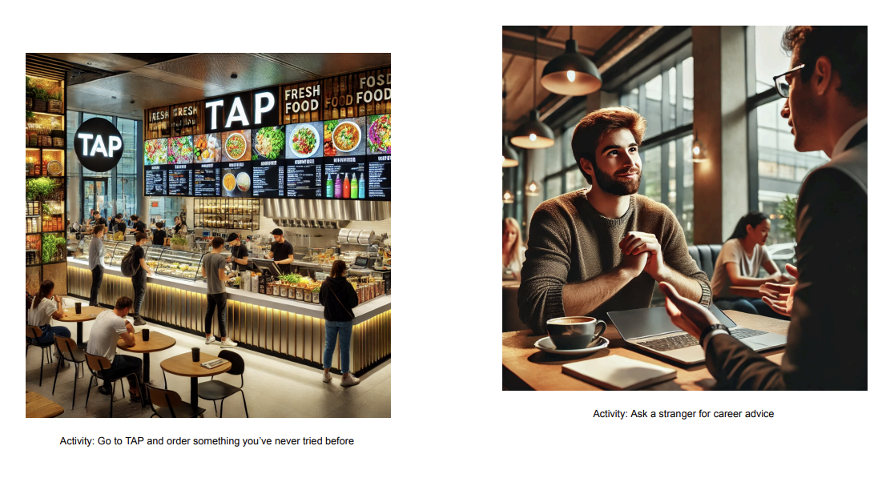
Problem & Solution #1
HMW empower young individuals to explore future possibilities without feeling restricted by convention?
Solution: An app where young individuals can swipe left or right on unconventional career exploration activities, partnered with local companies and organizations. Users are encouraged to perform tasks and reflect on their experiences, cultivating a culture of learning and discovery.
Novelty: An engaging, low-stakes way to explore unconventional career paths and opportunities that might otherwise feel daunting to explore.
Assumption: Users will follow through and perform the tasks that might be outside their comfort zone.
Test: Participants are presented with three unconventional activities, each represented by an image and brief description, and sort them into “yes” or “no” piles. They then complete the selected tasks, with pre- and post-surveys used to assess changes in their experiences and perspectives.
“I was a bit nervous at first but it ended up being fun!”
“I feel a little more motivated to put myself out there, you know, you get to learn so much that way.”

Slide 25
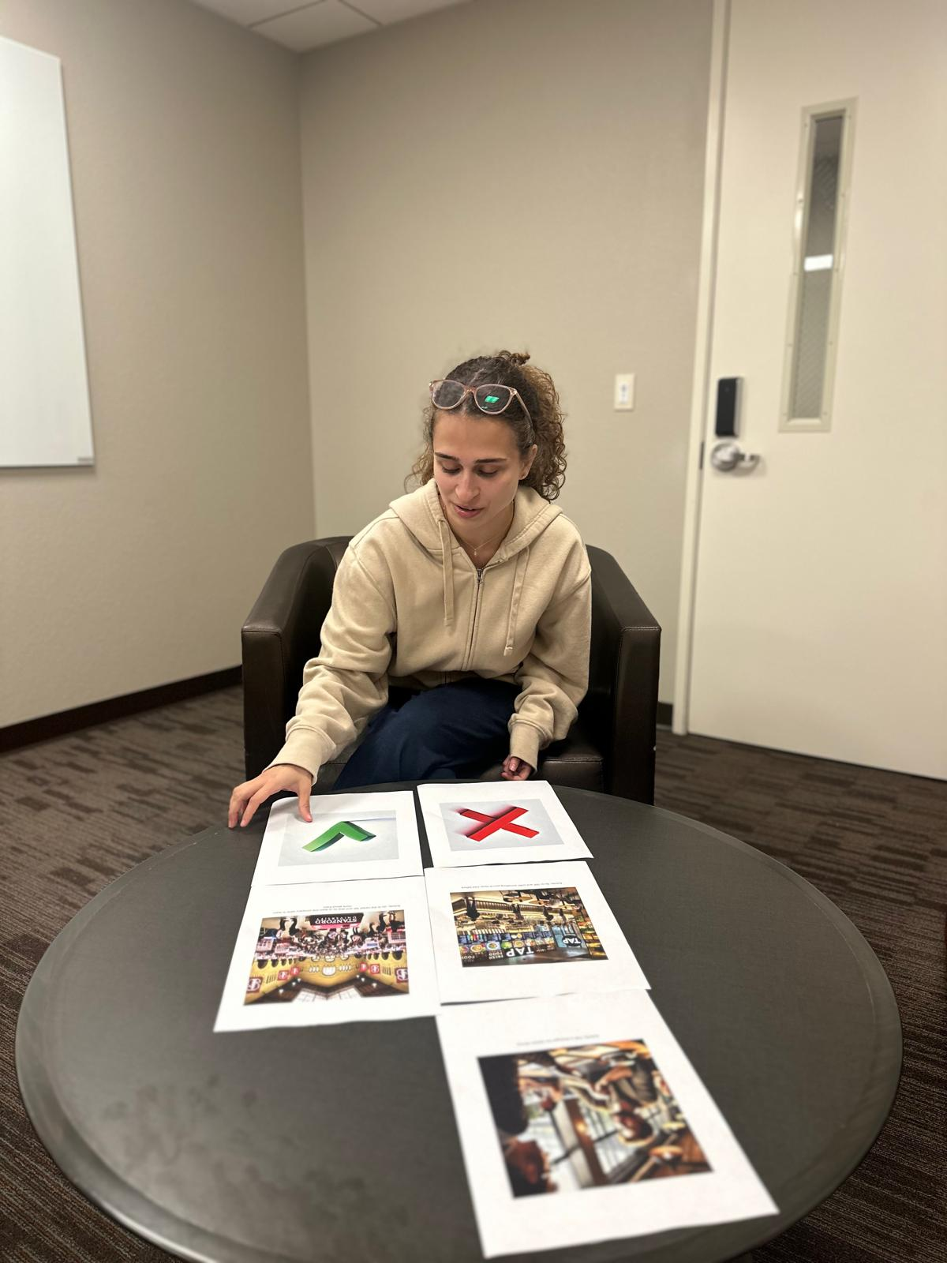
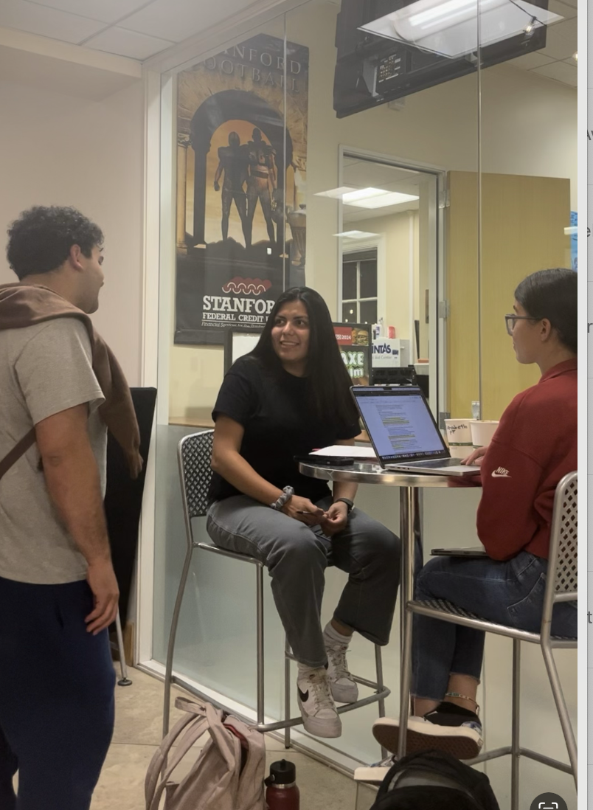
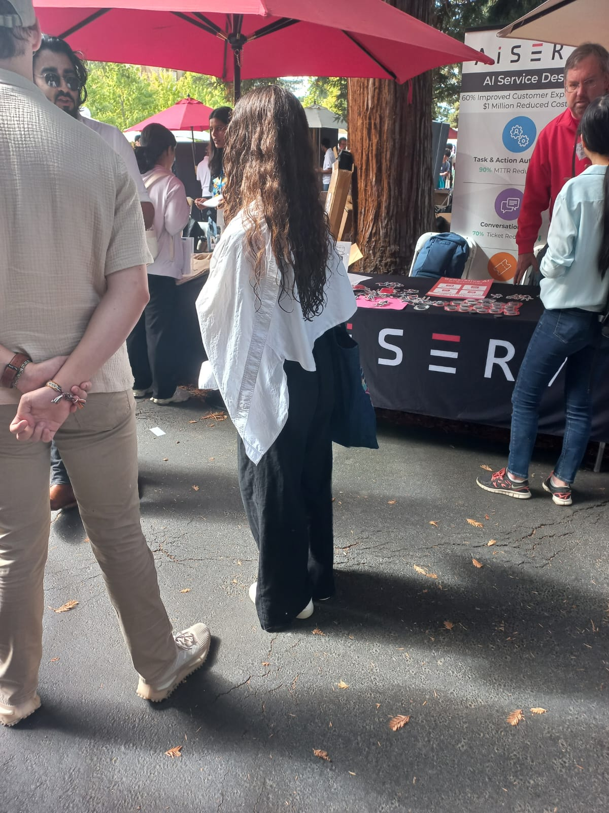
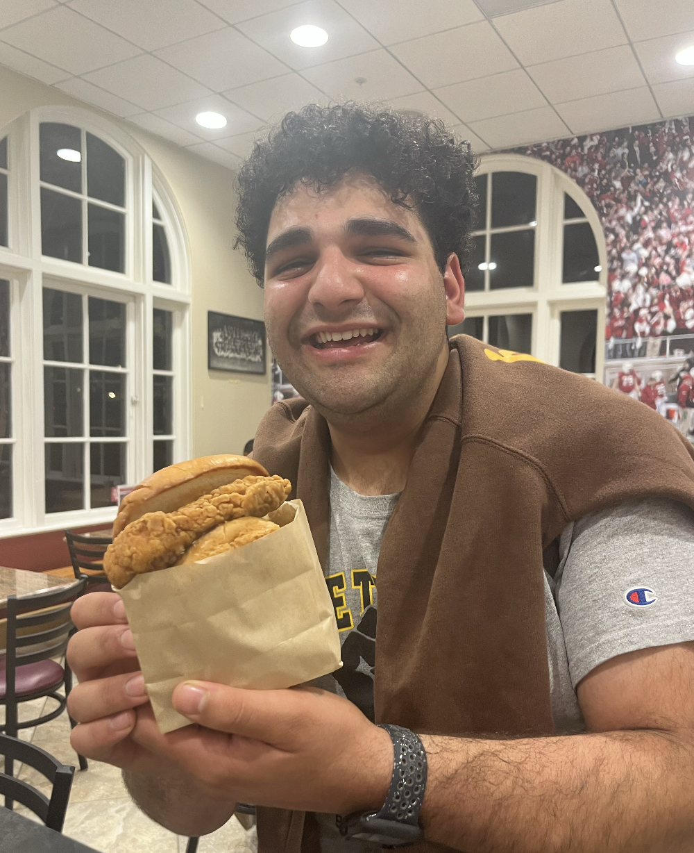
Experience Prototype #1:
Aya swiping on her tasks
Nico asking strangers for
career advice
Aya attending the career fair
Nico ordering a new item
From TAP!

Slide 26


Experience Prototype #1
Assumption: Users will follow through and perform the tasks that might be outside their comfort zone.
Participants?
2 Stanford undergrads
Successes
Struggles
Key Learnings
Participants completed all the tasks that they said yes to
Participants indicated an overall positive experience performing these tasks
Participants carried about these tasks immediately after saying yes to them
Participants initially felt uncertain on how to about these tasks
Some participants were turned down/faced restrictions in carrying out task
Participants indicated that “asking a stranger for career advice” seemed unrealistic
Even if individually were hesitant at first, they were motivated to complete tasks
Participants felt a sense of accomplishment and pride after successfully completing the task
Participants indicated that they feel a bit more open to trying or doing something new
Aya
Nico

Slide 27
HMW enable people to bring awareness to their existing lifestyle habits
Solution 2
A stress journal that correlates stress levels to specific habits. It provides personalized suggestions and insights, helping you optimize and tailor your habits for better stress management. Tracking features allow users to assign stress values to different things they do.

Slide 28
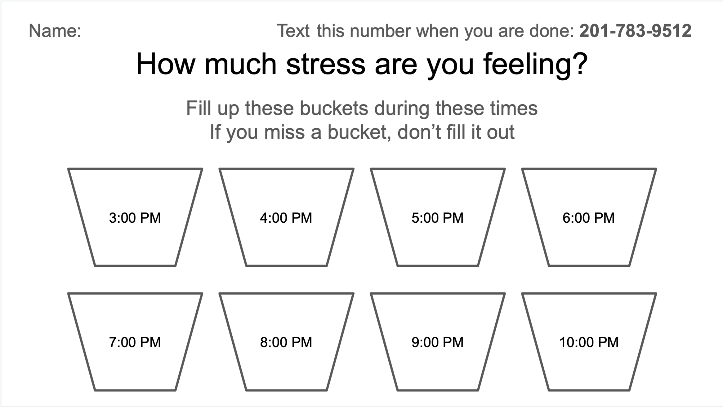
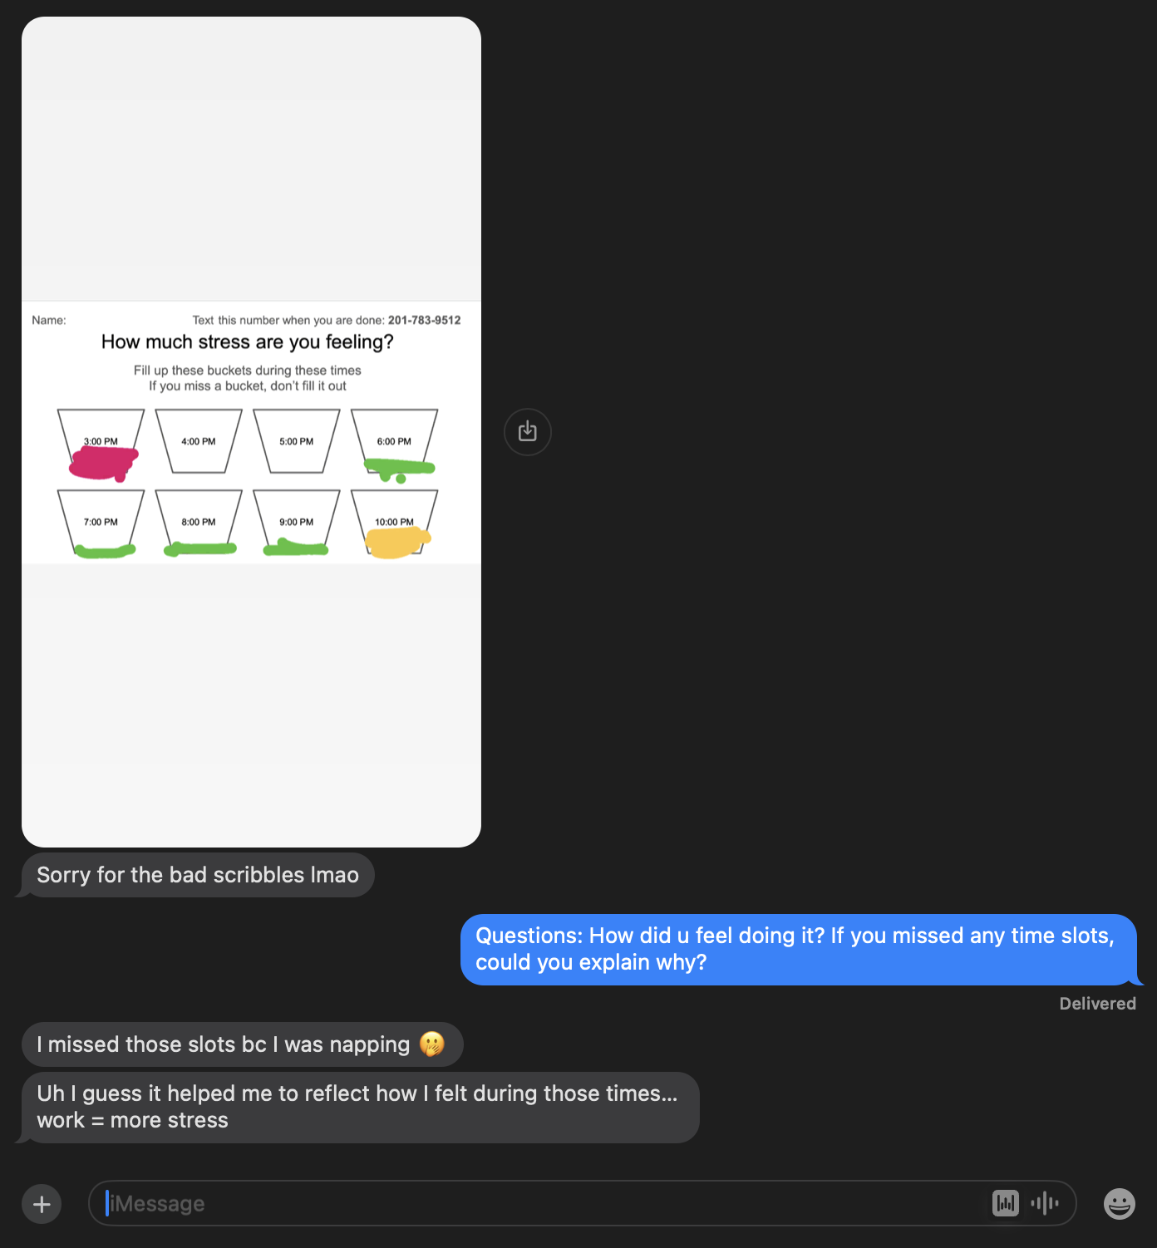
Problem & Solution #2
HMW enable people to bring awareness to their existing lifestyle habits
Solution: A stress journal that correlates stress levels to specific habits. It provides personalized suggestions and insights, helping you optimize and tailor your habits for better stress management. Tracking features allow users to assign stress values to different things they do.
Novelty: We have never seen a service that normalizes logging your stress levels throughout the day
Assumption: People are willing to track their stress multiple times a day.
Test: Individuals fill out a bucket diagram to represent their stress levels throughout the day, every hour from 3 pm - 10 pm. If they miss a bucket, they are not allowed to fill it out.
Once the individual has filled in all the buckets at 10 pm, they submit the diagram and are then ask a series of questions asking them to reflect on the exercise
“I actually like it. Very zen.”
“It felt nice to reflect and process what I was feeling and how my mood was changing over time.”
Stress logging throughout the day

Slide 29




Experience Prototype #2
Assumption: People are willing to track their stress multiple times a day
Participants?
2 Stanford undergrads,
2 Stanford alumni
Successes
Struggles
Key Learnings
Participants filled a majority of the buckets with differing levels of stress
Participants liked reflecting as the day went by
Participants liked understanding what times they are stress during the day
It was easy to forget to fill in the diagram especially in succession
People initially felt obligated to fill in the buckets
Further testing is necessary to see if people can keep logging for multiple days
Tracking your stress levels does make you aware of your stress
People enjoy logging their stresses down multiple times day
We want to create a method that allows easy recording of stress without being too invasive or annoying
Emily
Matthew
Chris
Ibrahim

Slide 30
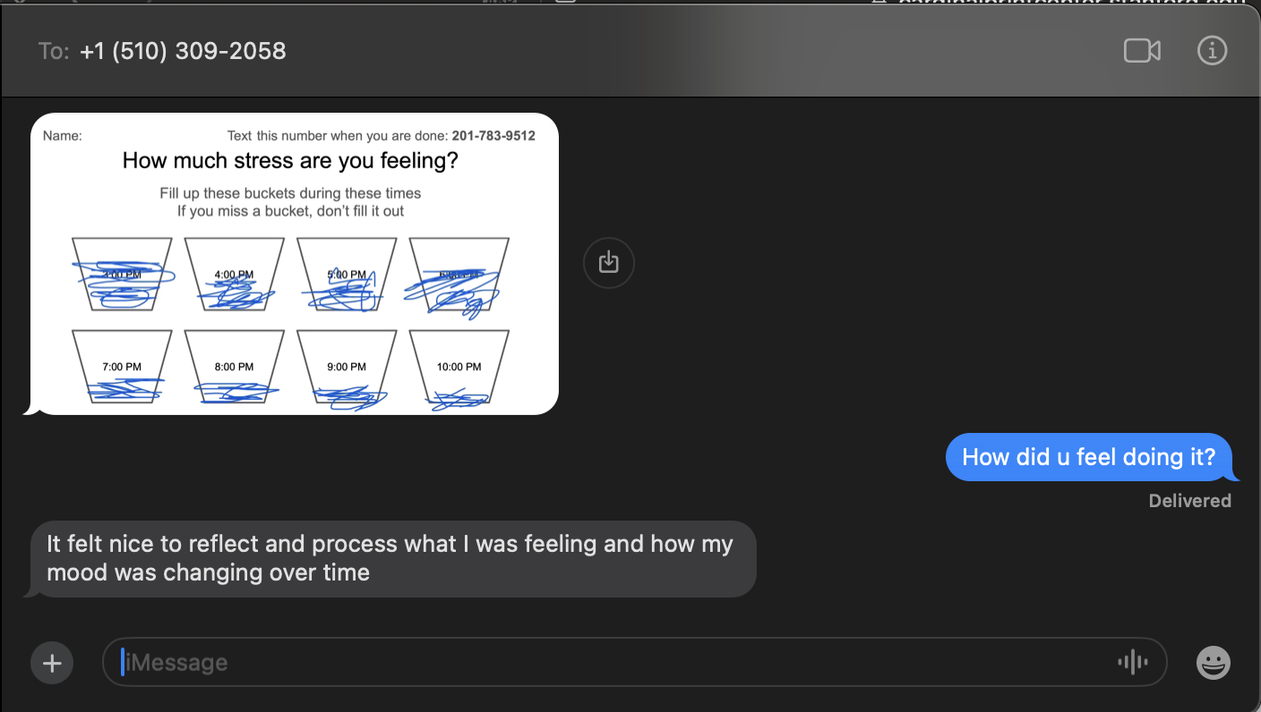
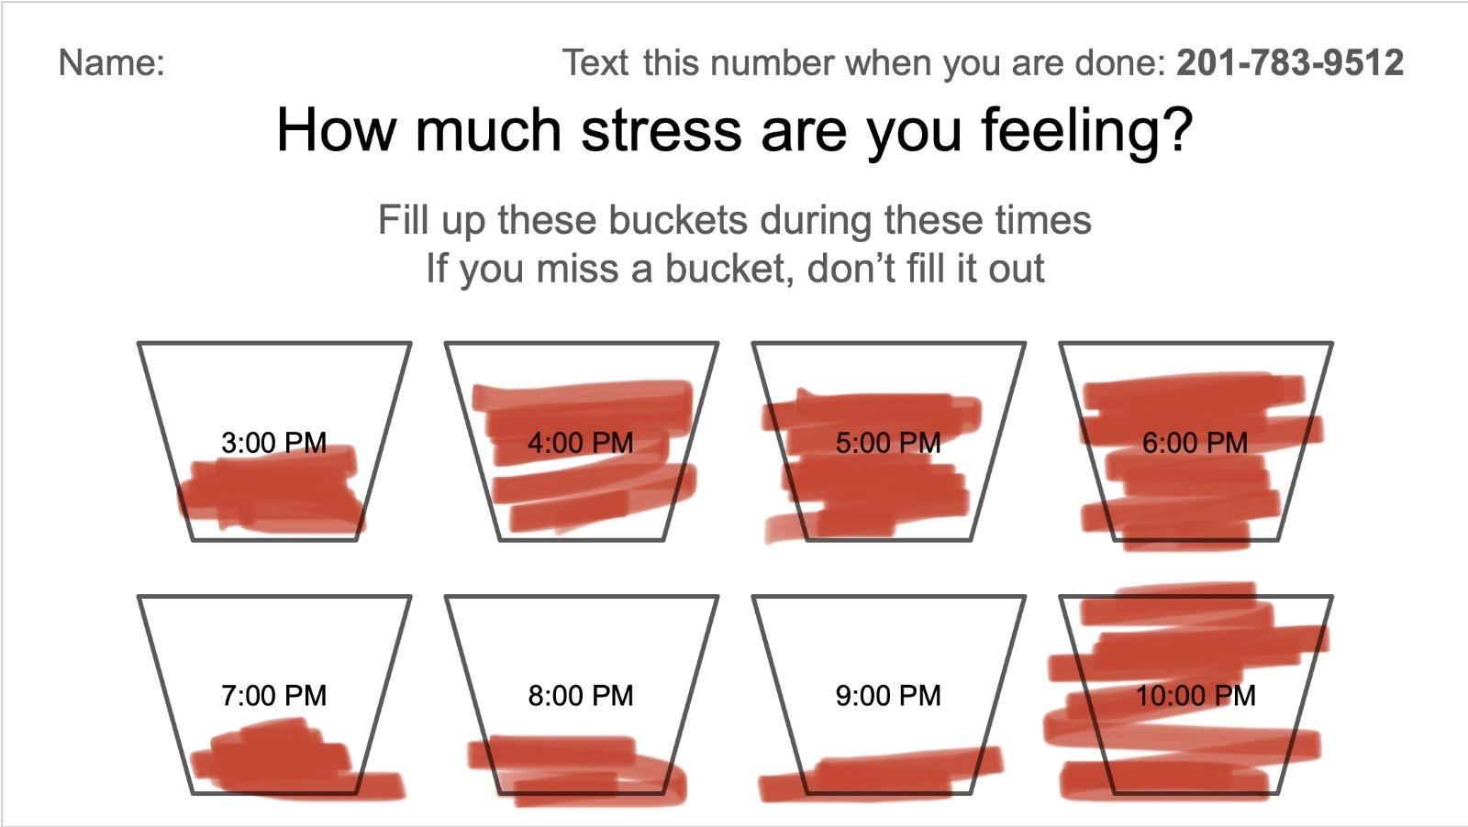
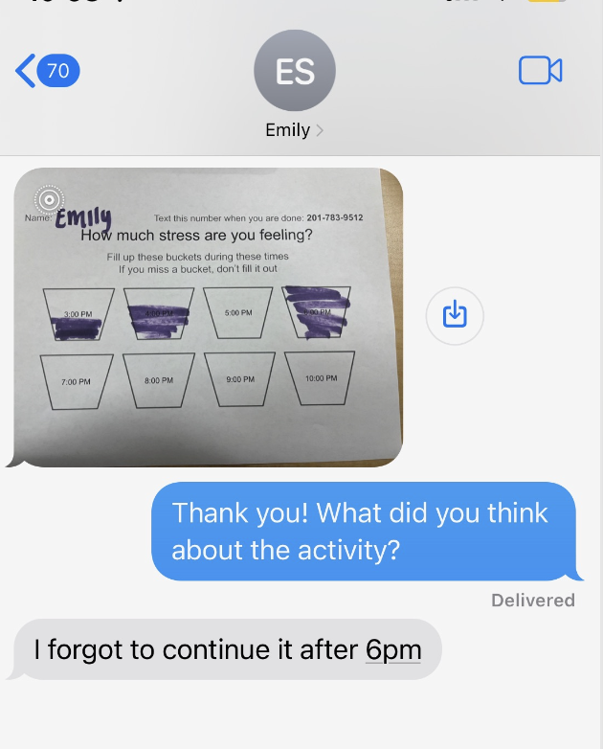
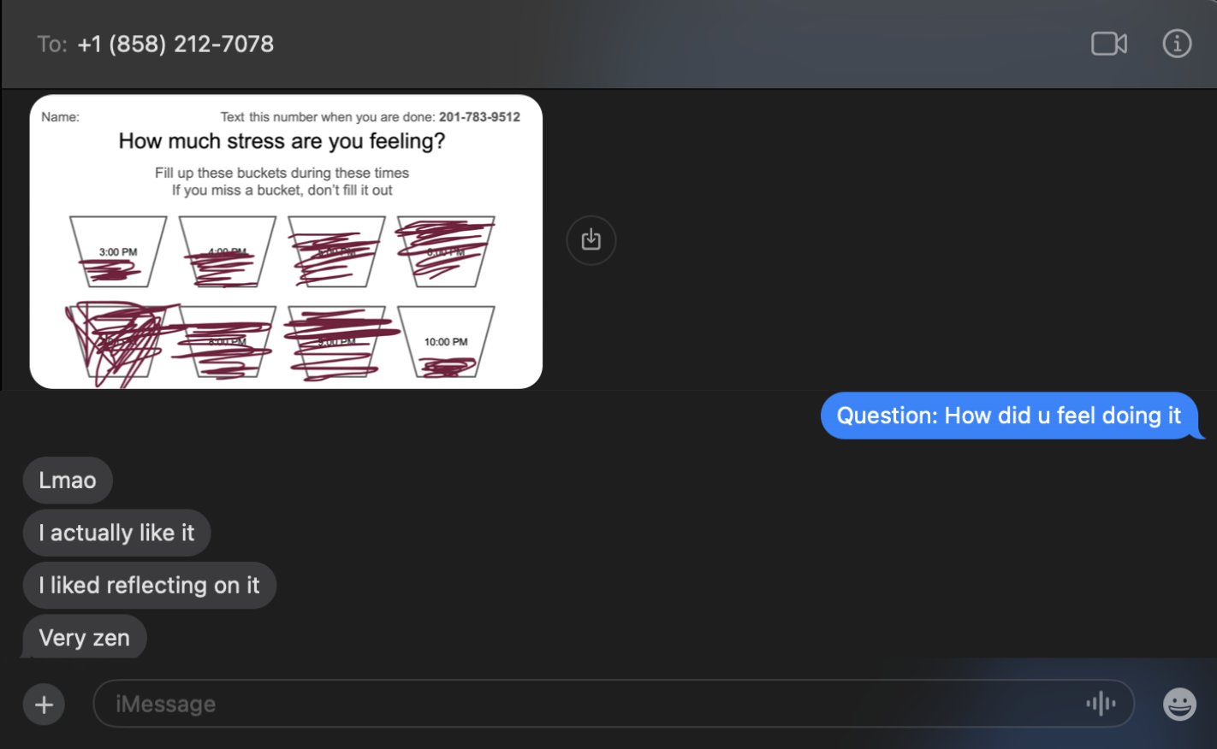
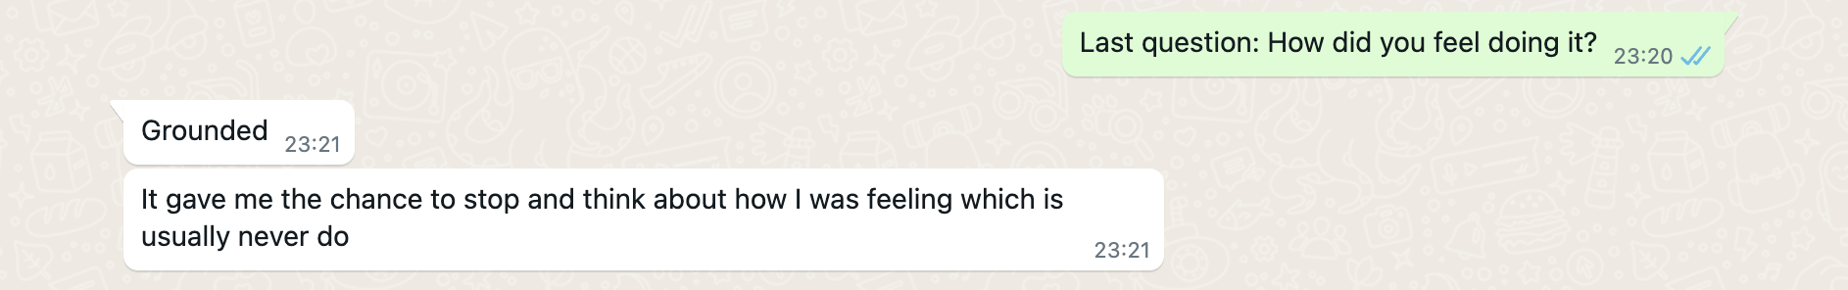
More Results from Solution 2

Slide 31
Solution 3
HMW mimic the feeling of direct impact, even when that may not be present?
An impact visualization tool that shows how a manager’s actions influence others and the broader system. It highlights the ripple effects of his contributions and identifies areas for improvement.

Slide 32
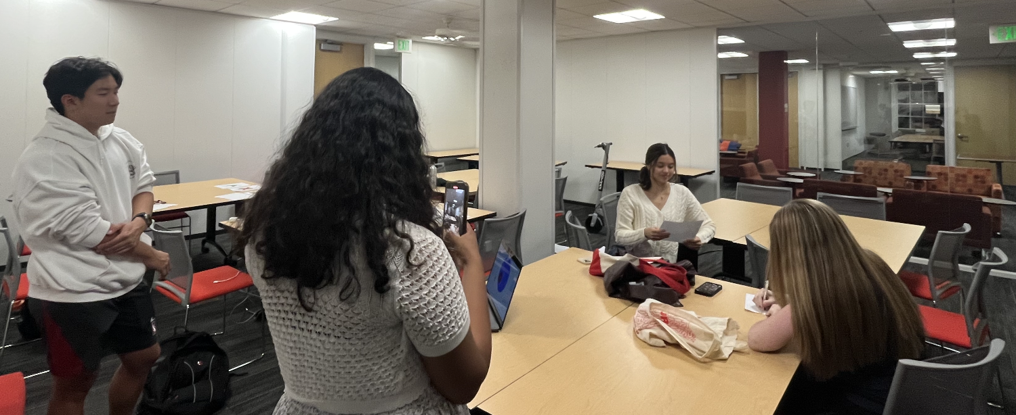
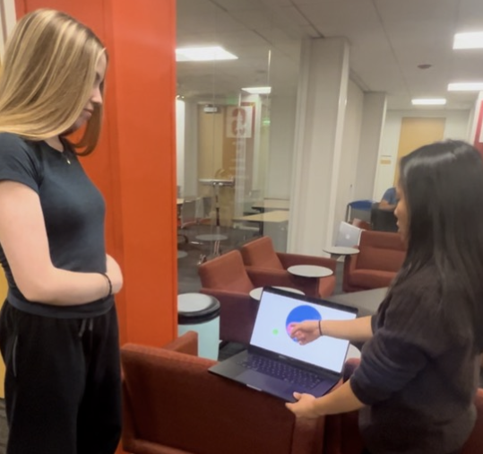
Problem & Solution #3
HMW mimic the feeling of direct impact, even when that may not be present?
Solution: An impact visualization tool An impact visualization tool that shows how a manager’s actions influence others and the broader system. It highlights the ripple effects of his contributions and identifies areas for improvement.
Novelty: This solution enhances perceived impact, accomplishment, and fulfillment even without direct impact and immediate feedback
Assumption: Seeing the scope of one’s own impact would reduce anxiety and make them feel more fulfilled
Test: Have two players participate in a social experiment. One subject is given a list of tasks that she relays to her sub manager. We ask the manager to leave the room while the sub manager relays the tasks to the lowest employee to do. In the meantime, the manager answers preliminary questions regarding their thoughts about the task and on the employee hierarchy. We then showed them an impact visualization tool specific to their situation, then asked follow up questions to assess the effects it had on the manager’s stress and work fulfillment.
“I don’t fully trust her [Chloe]”- Avery before completing activity
“I feel much better about Chloe’s managerial skills and how I influenced the work Ed did”- Avery after completing activity
Stress logging throughout the day

Slide 33


Experience Prototype #3
Assumption: Seeing the scope of one’s own impact would reduce anxiety and make them feel more fulfilled
Participants?
2 Stanford undergrads,
Successes
Struggles
Key Learnings
Participants indicated during the post-visualization quiz that the impact map did make them feel more trusting of the employees under them
Participants liked having a tangible measure for their impact and work
One participant felt even more unsatisfied being able to see the exact magnitude, or how low the lowest employee’s understanding of the task list was
The visualization tool was very bare bones and didn’t allow for any of the participants to engage with it
Providing tools such as this one can promote trust in the workplace, thus reducing stress
Too much transparency could cause tension and stress within a team dynamic
Participants did in fact feel more fulfilled and glad that they could see the impact they were making
Chloe
Avery

Slide 34
Prototyping Key Takeaways
Individuals are more likely to follow through on tasks they've personally selected.
Despite initial uncertainty, completing tasks leaves individuals with a sense of satisfaction.
Tasks requiring consistent logging are easily forgotten.
Participants appreciated seeing the impact of their contribution after delegating work to others

Slide 35
Chosen Solution
Solution #1: Allowing exploration of unconventional career exploration activities, partnering with local companies and organizations, for young individuals
Next Steps - Refining our Solution
Clarify task expectations through well articulated instructions
Ensure that the tasks are realistic for the average person to complete
Incorporate feedback loops within the app to allow users to share their experiences, motivating others
Expand user testing to get broader perspectives on the tasks
Make tasks more representative of unconventional career exploration

Slide 36
Ethical Considerations
 | Serves | Excludes
Usability | Individuals who want to understand their stress | Individuals who deny their stress
Accessibility | Anyone who can download the application | People without internet or digital skills or suffer from learning disabilities
Sustainability & Society | The younger, growing workforce who are learning how to deal with stress | People who do not empathize with others
Focus | Users trying to understand and optimize their stress patterns | Those who are addicted to social media and need external validation
User Involvement | Users open to regular notifications | Users who dislike or stressed by notifications
Privacy | Users who are willing to digitally track their personal lives | Those who are uncomfortable with uploading their personal experiences

Slide 37
Thank you !

Slide 38
Appendix

Slide 39
Danna’s HMW Brainstorming
Hmw remove the fear surrounding taking a different path
Hmw give people a safe place to experiment with different paths
Hmw connect danna with people who took unconventional paths
Hmw give danna the resources to pursue different paths
Hmw remove the stigma others cast on those following an unconventional path
Hmw ensure danna receives validation and value if she were to take a different path
Hmw place more emphasis on the journey and the process, rather than the end result
Hmw reduce the pressure to meet external expectations (ie: peers, parents, etc)
Hmw reframe the concept of taking a different path as growth, opportunity for success, and self discovery; rather than “quitting”, “dropping something”, or “giving up”
How might me improve her self worth?
How might we make others stop talking about their accomplishments?
Hmw bring perspective into how people are on different paths?
Hmw make people not base their self worth on just academic success
Hmw make hearing about others’ accomplishments be something inspiring instead of intimidating

Slide 40
Julie’s HMW Brainstorming
HMW help people understand their capacities better?
HMW bring more acceptance into not needing to optimize your lifestyle at all times?
HMW allow people to have balanced goals?
HMW help people achieve goals with more achievable/ broken down targets?
HMW make people more intentional with the things they choose to take on?
HMW make people more efficient with their time so they have time to do everything?
HMW make it less stressful to have a lot of things doing on?
HMW make people recognize where their capacity is / the max amount they can take on
HMW make it okay to not do everything?
HMW remove the stress barrier out of the picture, so that people have the capacity to pursue everything?
HMW leverage an individual’s context and derive insights in order to enhance their productivity?
HMW make sure people are aware of their current stress levels at a given time?
HMW leverage patterns in human tendencies to optimize productivity
HMW uncover how individuals experience and interpret their stress patterns?
HMW lower the barrier of mental energy required for different tasks

Slide 41
Dr. V’s HMW Brainstorming
HMW make it easier for Dr. V to delegate tasks
HMW help Dr. V see the impact of his work
HMW provide quantifiable measures of his impact
HMW make the managerial positions more like the patient-care positions
HMW can we center the word fulfillment around non-professional contexts
HMW create a system that allows Dr. V to manage several things and people at once
HMW give Dr. V immediate feedback on the work of the people under him
HMW improve team communication
HMW reframe delegating tasks around “trust” rather than “fear”
HMW make delegating tasks feel as impactful as directly helping a patient

Slide 42
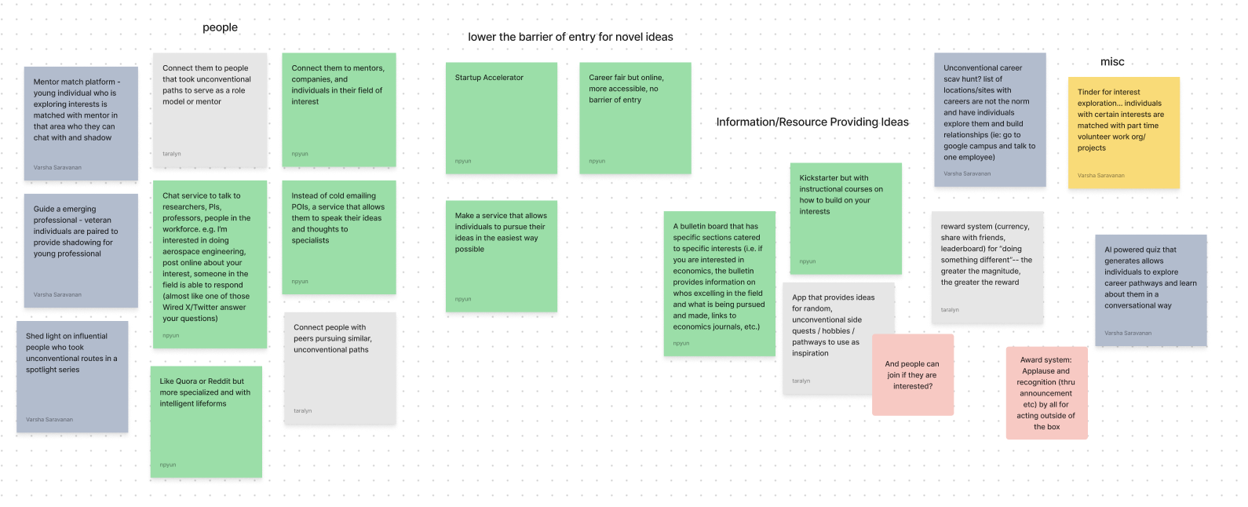
Solution 1 Brainstorming

Slide 43
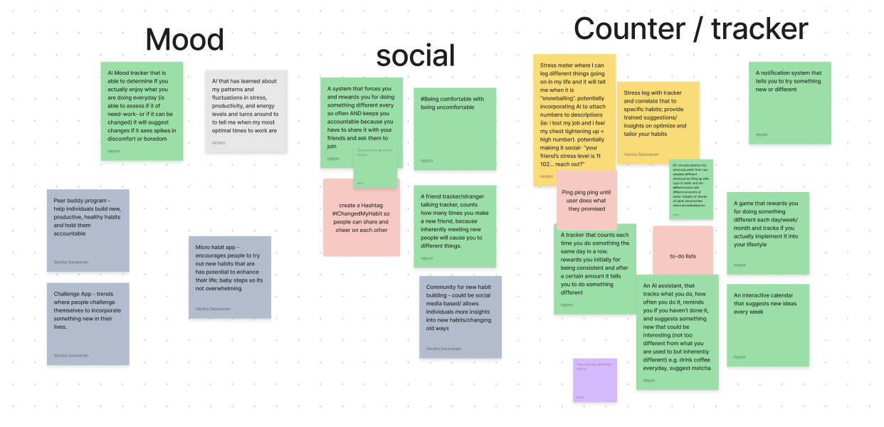
Solution 2 Brainstorming

Slide 44
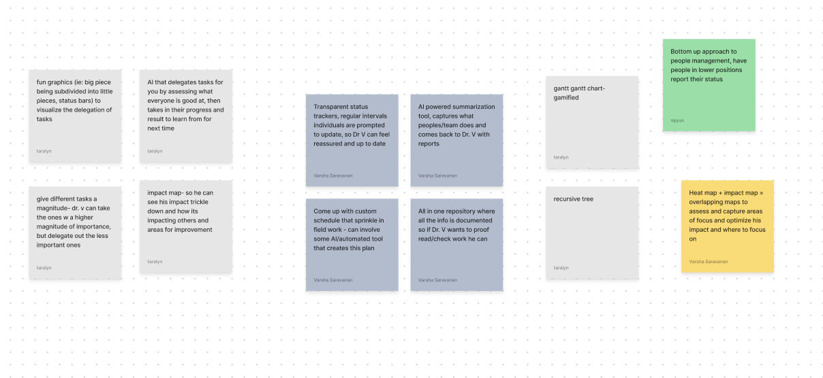
Solution 3 Brainstorming

Slide 45
Link to Additional Notes on Experience Prototypes
Experience Prototype Procedure, Notes and Results

